Slide 1
Studying Sn1 and Sn2 reactions: Nucleophillic substitution at saturated carbon

Slide 2
Synthesizing 1-Bromobutane
Under acidic conditions
In acidic conditions the OH exist in its conjugate base
The leaving group becomes water ( H₂O)

Slide 3
Nucleophile
Nucleophile come from : -Nucleo (nucleus ) and
–Phile ( Greek for Love) , you end up with Lover of nucleus.
Loves positive charges.

Slide 4
Electrophile
Lover of Electrons.
Are positively charged

Slide 5
Sn1 Reactions
Only the organic reactant is involved in the rate –determining step
Sn1 reaction conditions favor ionization of the organic reactant.

Slide 6
Sn1 reactions
The leaving group: The leaving group (L) must be a weak base
NH3 ammonia
CH3NH2 methylamine
C5H5N pyridine
NH4OH ammonium hydroxide
The carbon group: production of a carbocation, the reaction will occur faster for compounds that lead to more stable carbocation's.
Tertiary compounds react faster, primary compounds react very slowly
Carbocation's are also stabilized by resonance, if the compound produces a resonance stabilized carbocation it occurs much faster

Slide 7
Sn1 reactions
The solvent: Ionization occurs faster when the solvent is polar
Rate of Sn1 is directly dependent on ionization

Slide 8
Sn2 reactions
Two organic species participate in the rate –determining step. The organic reactant and the nucleophile
The reaction starts when the nucleophile attracts the carbon and causes the leaving group to leave.

Slide 9
Sn2 reactions
The leaving group: A weak base
The carbon group: unhindered by the presence of bulky groups is better for Sn2 reactions

Slide 10
Sn2 reactions
The nucleophile: When the attacking atoms are of similar size nucleophilicity parallels basicity.
When they are of different size, the larger more polarizable atoms are more nucleophilic
The solvent: Occur faster in polar aprotic solvents, DMSO is a good polar aprotic solvent.

Slide 11
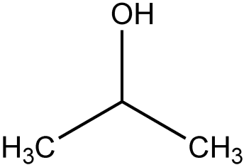
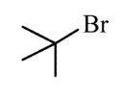
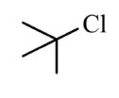
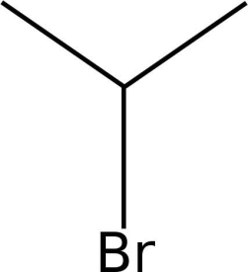
Factors affecting the rates of Sn1 reactions.
2-propanol
2-bromo-2-methylpropane
2-chloro-2-methylpropane
2- bromopropane

Slide 12
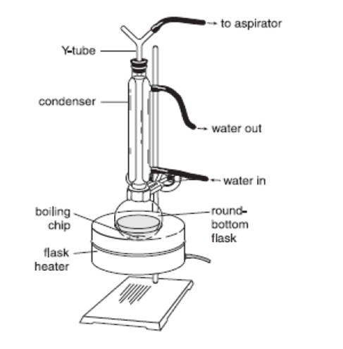
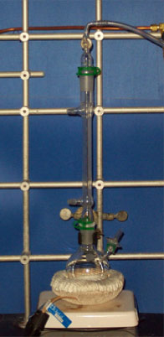
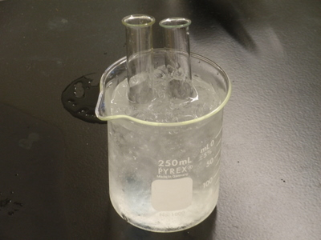
Experimental set up

Slide 13
Dehydrating Cyclohexanol

Slide 14
Elimination reactions
Occurs when a small molecule (H-X) is expelled from the adjacent carbon atoms.
A pi-bond is formed, good for producing alkenes and alkynes.
Heterolytic bond cleavage : Occurs when one atoms leaves a compound with both electrons of the original bond, resulting in the formation of ions.

Slide 15
Heteroclytic bond cleavage

Slide 16
Dehydration
Elimination of water (H-OH) from alcohols
Acid catalyzed
E1 mechanism

Slide 18
E1 mechanism
Oxonium ion
Carbocation ( carbon with a positive charge)
Alcohols are classified by the number of alkyl groups attached to the carbon bearing the –OH group.
Tertiary (3°), Secondary (2° ) and Primary ( 1°)

Slide 19
Stability

