Slide 1
Midterm Review for Organic I lab

Slide 2
Separating cyclohexene from toluene by distillation

Slide 3
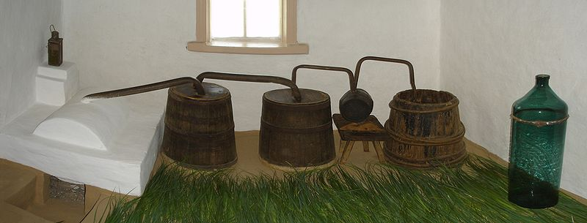
Distillation is a proses by which we separate compounds based on their boiling point.
Many organic compounds are volatile; that is they exhibit a relatively high vapor pressure and they have a relatively low boiling point
Compounds that exhibit high vapor pressures are more easily evaporated. This is done by applying heat
By applying heat we can separate the more volatile compound from the less volatile compound
Crude vodka distillery

Slide 4
In this lab we separated toluene from cyclohexene .
Cyclohexane Toluene
Cyclohexene is a six member ring with no unsaturations (double bonds)
Toluene is a six member ring with alternating unsaturations (a benzene ring) with one methyl substitution

Slide 5
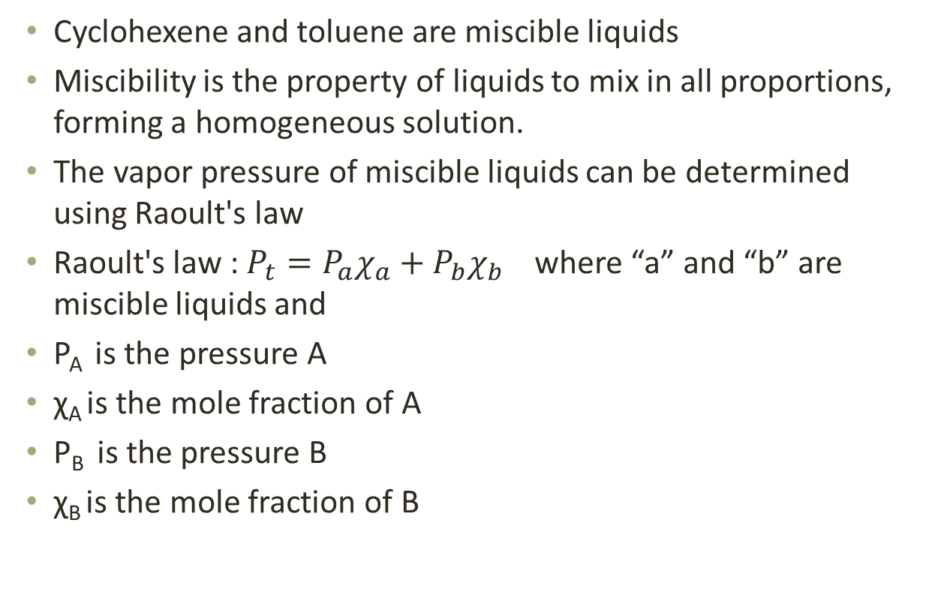
Miscible liquids
Cyclohexene and toluene are miscible liquids
Miscibility is the property of liquids to mix in all proportions, forming a homogeneous solution.
The vapor pressure of miscible liquids can be determined using Raoult's law
Raoult'slaw : $P_{t}=P_{a}χ_{a}+P_{b}χ_{b}$ where “a” and “b” are miscible liquids and
P_{A} is the pressure A
χ_{A} is the mole fraction of A
P_{B} is the pressure B
χ_{B} is the mole fraction of B

Slide 6
What is the total vapor pressure by a 50:50 molar mixture of methyl alcohol (vapor pressure-13.02 kPa )and propyl alcohol (vapor pressure -1.99 kPa) assume the compouds are miscible

Slide 7
There are two distillation methods– simple and fractional distillation.
Simple Fractional

Slide 8
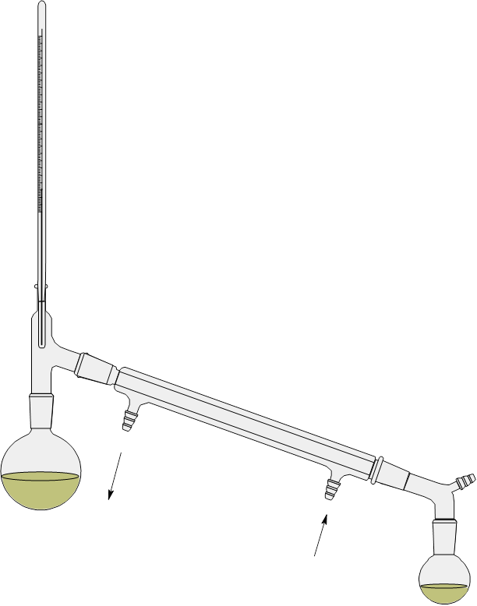
Simple distillation
Simple distillation consists of …
A pot
A three way connector
A thermometer
A condenser
And a receiver
Thermometer
Condenser
Three way adaptor
The Pot
Receiver

Slide 9
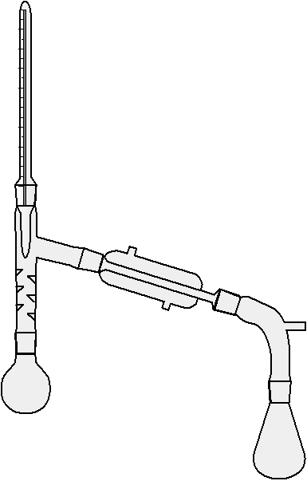
Fractional distillation
Fractional distillation consists of ….
A pot
A fractional column
A thermometer
A condenser
And a receiver
Condenser
Thermometer
Receiver
Fractional column
The pot

Slide 10
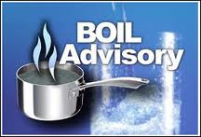
Boiling chip
Both simple and require the aid of a boiling chip.
The boiling chip provides surface area which allows for the liquid to smoothly boil
Adding the boiling chip to an already boiling liquid will cause the liquid to violently foam out of the container (I have seen it happen)

Slide 11
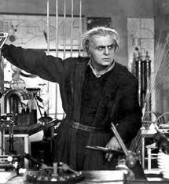
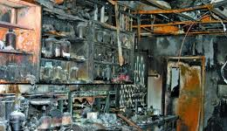
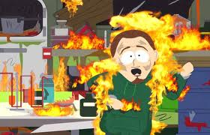
Other hazards
If the pot is allowed to dry it could start to combust (burn or explode)

Slide 12
Isolation of clove oil from cloves using steam distillation

Slide 13
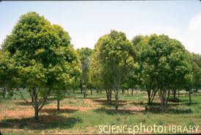
Clove oil
Clove oil belongs to a class of natural products called essential oils
Clove oil comes from the clove tree ( Eugenia caryophyllata)
The two major compounds in clove oil are eugenol and eugenol acetate

Slide 14
Clove oil
Eugenol Eugenol acetate
85-90% 9-10%

Slide 15
The many possibilities of steam distillation
Steam distillation can be carried out in two ways
Method #1: excess water is added to the compound in a distilling flask. The mixture is then heated to the boiling point. The resulting vapor is then condensed and collected in a receiving flask.
In this lab we performed steam distillation using method#1 simply because it was easier.
Separatory funnel containing water
condenser
The reciever
Claisen adaptor
The pot

Slide 16
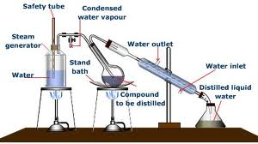
The many possibilities of steam distillation
Method #2: steam is bubbled into the compound of interest to effect the distillation

Slide 17
Immiscible liquids
When immiscible two compounds are distilled together it is called co distillation and when one of the compounds is water the process is called steam distillation
Steam distillation allows compounds with high boiling points to distill at relatively low temperatures (around 100 C)
This intern prevents oxidation of the compound that would have other wise occurred at high temperatures.
The vapor pressures of immiscible liquids can be calculated using Dalton's law

Slide 18
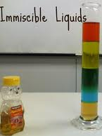
Dalton’s law and
Dalton’s law states that the vapor pressure of a immiscible liquid is the sum of the vapor pressures of the pure compounds. This is assumed since it is believed that each liquid will vaporize independently of the other liquid
P_{t}= P₁ + P₂
Where P_{t} is the total vapor pressure
P₁ is the vapor pressure of compound 1
And P₂ is the vapor pressure of compound 2

Slide 19
More tests to come
In order to test for the presence of eugenol and eugenol acetate we conducted 3 chemical test.
We tested for the presence of unsaturations (double bonds) using both molecular bromine and potassium permanganate
And we tested for the presence of phenol groups ( hydroxyl groups on an aromatic ring) using Iron (III)

Slide 20
Eugenol with bromine and potassium permanganate test

Slide 21
Eugenol acetate with bromine and potassium permanganate test

Slide 22
Iron (III) tests

Slide 23
Isolating caffeine from tea

Slide 24
Caffeine the magical drug
Caffeine belongs to a group of compounds know as the alkaloids.
The alkaloids are known for producing an alkaloid solution in the presence of water
This is due to the presence of nitrogen atoms that act as bases

Slide 25
The xanthines
Caffeine further more belongs to a subclass of compounds known as the xanthines.
The xanthines are structurally very similar and only differ in the placement of methyl groups (-CH₃)
Xanthine caffeine theophylline theobromine

Slide 26
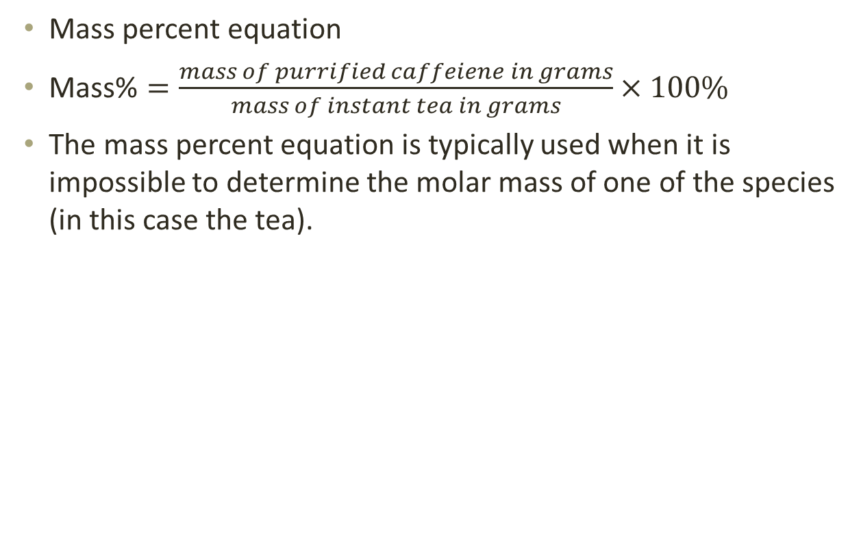
Mass percent
Mass percent equation
$\text{Mass}\text{\%}=\frac{mass of purrified caffeiene in grams}{mass of instant tea in grams}×100\%$
The mass percent equation is typically used when it is impossible to determine the molar mass of one of the species (in this case the tea).

Slide 27
Purifying acetanilide by recrystallization

Slide 28
Synthesis of acetanilide
Aniline Acetic anhydride Acetanilide Acetic acid

Slide 29
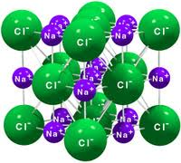
Purification
Recrystallization is a method of purifying a compound by which impurities are removed from organic compounds that are a solid at room temperature
The recrystallization solvent plays a major role
Typically the substance that is to recrystallized is not soluble at room temperature but as the temperature is increased the solubility increases as well

Slide 30
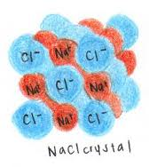
Purification
Recrystallization is done by completely solubilizing the solid substance in a suitable solvent. Afterwards activated carbon is added in order to remove impurities.
The solution is then allowed to cool forming “pure” crystals

Slide 31
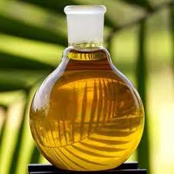
Oiling out
Oiling out occurs when a compound is insoluble in a solution at temperature above the compound's melting point.
As a result the compound is deposited as an oil and not a crystal.

Slide 32
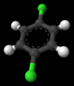
Oiling out
For example dichlorobenzene has a melting point of 53 C
Dichlorobenzene is not soluble in water at 100 C
If the student uses water to recrystallize the compound it will oil out

Slide 33
Like dissolves like
Substances are most soluble when the polarity of the solvent is similar to the polarity of the compound
For example compounds that contain a hydroxyl group (-OH), amino group (-NH₂) and a carboxylic acid (-COOH) are considered to be polar at least in part and will have, at least, partially polar
Thus compounds containing such functional groups will more than likely be soluble in polar solvents

Slide 34
Like dissolves like
Which one of these compounds would you expect to be soluble in water

Slide 35

Percent yield
Percent yield is the percent of is the amount of product obtained in a chemical reaction
Yield can be calculated in reference to grams or in reference to moles but molar yield is usually preferred

Slide 36
Example: calculate the percent yield for the synthesis of acetanilede if you used 50ml of a 5M solution of aniline (assume excess acetic anhydride), and you collected 2g of pure acetanilide

Slide 37
Measuring the melting points of compounds and mixtures

Slide 38
What is melting point
When a substance’s liquid state is in equilibrium with its solid state the compounds is at its melting point.
if a pure compound is contaminated with “soluble” substance the melting point range will typically drop and broaden and it be a melting point range
The broadening of the melting point will depend on the level of contamination.

Slide 39
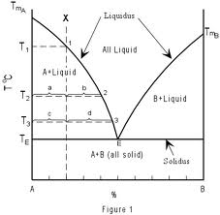
melting point mass percent composition diagram

Slide 40
melting point mass percent composition diagram
The curves separating the fields of A + Liquid from Liquid and B + Liquid from Liquid are termed liquidus curves.
The horizontal line separating the fields of A + Liquid and B + Liquid from A + B all solid, is termed the solidus.
The point, E, where the liquidus curves and solidus intersect, is termed the eutectic point. At the eutectic point in this two component system, all three phases, that is Liquid, crystals of A and crystals of B, all exist in equilibrium.
Vocabulary words on this slide are FYI

Slide 41
Things that may go wrong
If too much compound is packed in the capillary tube, then this will cause uneven heat distribution
If the compound is too course and air pockets are allowed to form this will also cause uneven heat distribution
If the temperature is heated faster than a rate of 1-2 C per minute this will also cause un even heat transfer
Uneven heat distribution will cause faulty data

Slide 42
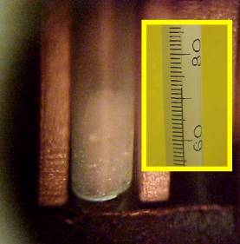
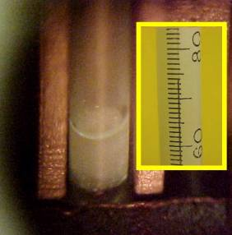
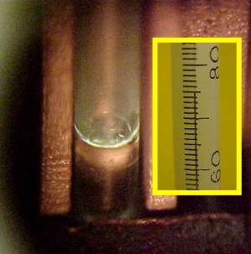
Things that may go wrong
Sometime slight changes, such as shrinking and sagging, occur in the crystalline structure occur. This should not be confused with actual melting.

Slide 43
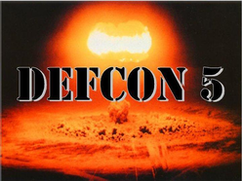
Things that may go wrong
Often compounds may be unstable at their melting point and will decomposed
This is usually seen as a darkening of the compound
Sublimation is when a solid compound goes directly to from its solid state to its gaseous state.
Usually this is seen as compound recrystallizing at a higher point in the capillary tube

Slide 44
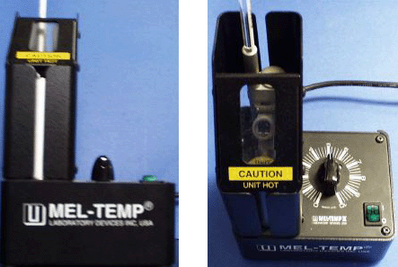
Equipment
Mel-temp apparatus consists of an aluminum block that is electrically heated.
It can withstand temperatures of 400C and up to 500C for a short period of time.

Slide 45

ANY QUESTIONS

